Slide 1
National Hydrology Project
Central Ground Water Board
WB Mission: 1-15 September 2015
14.09.15

Slide 2
HP I
Hydrology Project I: 9 Peninsular States
Objectives
Strengthening of Ground Water monitoring network
Standardization of methodologies for data collection & validation
Infrastructure development: labs & building
Institutional strengthening including capacity building and Software development for data processing, storage and dissemination
Achievements
2239 observation wells have been constructed
Computer data centre has been set up and water quality laboratories had been upgraded.
Dedicated ground water processing and application software, named as Groundwater Estimation and Management System (GEMS) has been developed for Ground Water Data Processing

Slide 3
HP II
Hydrology Project II: 13 States
Objectives
Institutional Strengthening
Horizontal Expansion in four new States covering Goa, Himachal Pradesh, Punjab & Pondicherry
Vertical Extension in the 9HP-I peninsular States.
Achievements
Institutional Strengthening
19 Server & 59 Workstation have been procured for up-gradation of data centre
Awareness raising programs – 32 Nos
Domain specific training - 27
Officers of CGWB deputed for 8 International Training courses
Development of e-GEMS, web based solution for Ground water data processing software (GEMS) and is to be hosted
Horizontal Expansion:
PZ constructed in new States(Goa -49; Punjab -65)
Vertical expansion:
Groundwater Modeling software
PDS
Pilot Project on Aquifer Mapping
Planning & designing of AR structures in sub urban of Chennai

Slide 4
eGEMS- Outlines
Internet based & platform independent system
Client access from web browsers
No software requirement at user end – Web browser and internet access needed
Single, centralized data store for databases.
Scalable to user requirement
13 participating States & CGWB to host data in a centralized repository.
Data Access
Currently data access is only for State/CGWB authorised persons only
CGWB Data can be accessed by all participating agencies
Data of concerned State to be viewed & changed only by the concerned State .

Slide 5
Role & Responsibilities
Standardization of structure for data storage by the State agencies
Optimization of network for monitoring of water levels & water quality
Knowledge Sharing through trainings, meetings & sharing of reports & findings
Technical assistance to State Agencies on any specific requests

Slide 6
Groundwater Issues for consideration in NHP
Requirement of Uniform Data structure for storage & retrieval
For easy data sharing.
Concurrence of State agencies required for storage & sharing
13 participating agencies have agreed to host data but the ownership rests with State agencies only
Constraints – Different Data pricing policy of different State governments.
More than one department monitoring groundwater for levels and quality as per their mandates in each State
Need for a nodal department for consolidation for each State
Act as pivotal point for data migration and sharing.

Slide 7
Project Objectives
Real-time Water quality monitoring in the coastal aquifer system in Tamil Nadu & Puducherry as pilot study before taking up on a large scale
up-gradation of eGEMS : Creation of Standardized scientific database for groundwater, for the whole country on a single platform
Capacity building: Through international exposure & transfer of knowledge through domain specific training to State Govt. officers
Basin Management Plan: Preparation of basin management plan for 10 basin along with CWC through consultancy

Slide 8
Project Success Indicators
Establishment of real time water quality monitoring system in parts of Tamil Nadu & Puducherry Coast
Availability of standardized scientific database for whole the country on the same format & platform.
Number of Trained officers in the Board & in States
Basin Management Plan for 10 basins

Slide 9
Proposed Financial Outlay
Total outlay : Rs 83.97 Cr

Slide 10
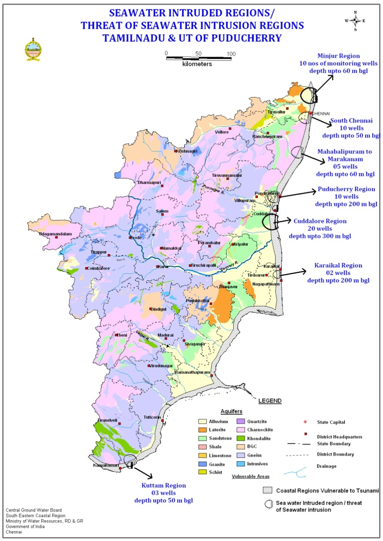
Component A: Hydromet Informatic System
Real time Monitoring (60 Nos)
Construction of PZ
Installation of real-time monitoring systems
Construction of Pz | Rs 435 Lakh
DWLR (Telemetry) with WQ probe as services | Rs 255 Lakh
Total | Rs 690Lakh

Slide 11
Component A: Hydromet Informatic System
Establishment of Centre of excellence at Faridabad (Rs 956 Lakh)
Centre would provide facility for modeling for CGWB offices & for State Agencies on request
Financial implications
Goods
HW : 26 Lakh
SW : 99 Lakh
AMC : 63 Lakh
Centre Establishment : 10 Lakh
Consultancy : 288 Lakh
Hiring of consultant Level 1
@ Rs 6 Lakh/month for 48 months
Operation Cost: 470 Lakh
Hiring of Consultant Level 2 @ Rs0.5 Lakh/month for 84 months

Slide 12
Component B: up-gradation of eGEMS
Total outlay : Rs 2300 Lakh
Scope of work
Design, Development and Implementation of Additional Modules of e-GEMS
Integration of data of all States
Training for users of all States
Benefits/Outcome
States to get a standardized database
No financial implication for the States
Easy storage, retrieval & analysis
CGWB database available for planning

Slide 13
Component C: PDS Study in sub-basin above Ramganga confluence of Ganga Basin
Total Outlays: Rs 2400 Lakh
Scope of work
Drilling of wells down to 300 m bgl
Water quality sampling & analysis
Isotope dating
Surface water –groundwater interaction
Aquifer response modeling
Pilot study at select locations for aquifer remediation
Outcome:
Demarcation of contaminated zones within aquifer
Aquifer-stream relationship
Feasibility of aquifer remediation

Slide 14
Component C: Consultancy for Basin Management Studies in 10 basins along with CWC
Financial Outlay : 11.0 Cr
10 basins identified by CWC
First 3 years of the project
1. Bharatpuzha, Kerala
2.Son
3. Chambal
4. Tapi
5. Theesta
From 4 year onwards
6.Subarnarekha
7. Damodar
8. Pennar
9. U.Godavari
10. U.Mahanadi up to Hirakud

Slide 15
Component D: Capacity building
S.No | Activity | Total in Lakh | No of Beneficiaries /per training
1 | International Training | 560 | 1
2 | Domain specific training | 48 | 15-20
3 | Awareness Programme | 48 | 75-100
4 | Training on collaboration with USGS | 295 | As per MoU to be signed
Total |  | 951

Slide 16
NHP : CGWB support to the States
Real-time Water Quality monitoring:
pilot study to show case the outcome
Pave way for lateral expansion into other parts of the country
Could be jointly taken up by CGWB & State Groundwater Departments for strengthening the water quality monitoring on priority basis.
eGEMS would provide a common platform for all State groundwater departments
To host the data on a common platform,
For easy storage, retrieval and analysis of data
No cost on the participating agencies.
Transfer of knowledge and technology
Results of the studies are being shared with State agencies
Results of the studies to be carried out in NHP would be shared with all concerned
Domain specific trainings & awareness campaign
Knowledge & technology transfer to all participating agencies and other Stake holders through interactions
Documents to be shared at appropriate platform for knowledge dissemination.
Regional Directors of the Regions would offer technical guidance
As and when sought by the State Groundwater Departments

Slide 17
NHP : What CGWB needs from States
States may place their request on what is expected from CGWB
On request from the States, respective Regional Directors would extend all cooperation in meeting the demand

Slide 18
Thanks

